Slide 1


In-Memory Big Data Management and Processing: A Survey
Prabesh Adhikari

Slide 2
Acknowledgement
This work was supported by A*STAR project 1321202073.
The authors would like to thank the anonymous reviewers,and also Bingsheng He, Eric Lo, and Bogdan Marius Tudor for their insightful comments and suggestions

Slide 3
Abstract
Development of in-memory big data management and processing systems.
In-memory systems are more sensitive to other sources
Fault-tolerance and consistency are also more challenging to handle in in-memory environment.
Aims to provide a thorough review of these proposals and systems.

Slide 4
Introduction
Have become increasingly popular due to the high speed of in-memory access compared to disk access.
Can support real-time data analytics and ultra-low latency service.
Key research areas in in-memory data management include:
Indexes
Data layouts
Parallelism
Concurrency control
Query processing

Slide 5
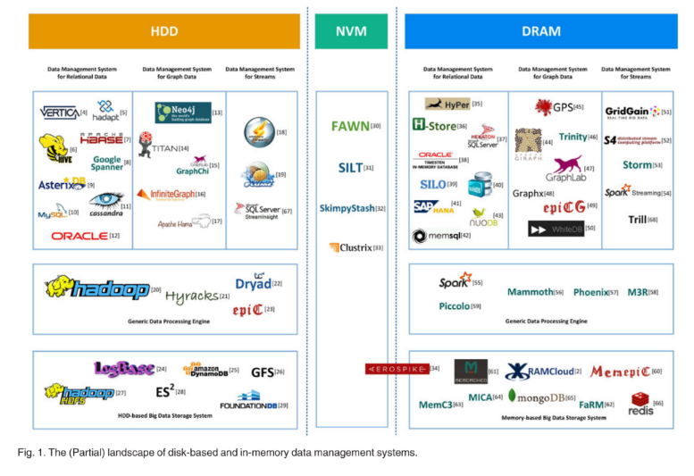

Slide 6
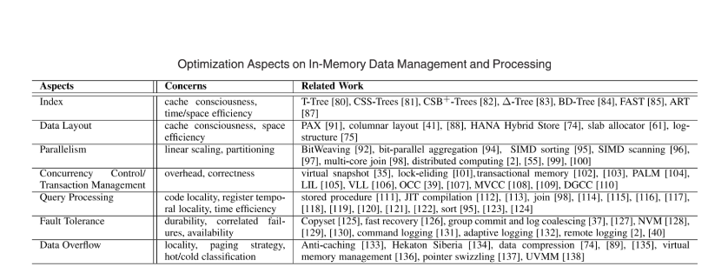

Slide 7
CORE TECHNOLOGIES FOR IN-MEMORY SYSTEMS
Memory hierarchy is important for efficient in-memory data management.
The memory hierarchy consists of registers, caches, main memory, and disks.
Registers are the fastest memory layer, followed by caches, main memory, and disks.
The memory hierarchy can be utilized by exploiting spatial and temporal locality.

Slide 8
IN-MEMORY DATA STORAGE SYSTEMS
In-memory relational databases are a type of database that stores data in memory rather than on disk. This can lead to significant performance improvements for OLTP workloads.
Some popular in-memory relational databases include SAP HANA, VoltDB, Oracle TimesTen, and Microsoft Hekaton.
Hekaton is a memory-optimized OLTP engine fully integrated into Microsoft SQL Server. It is designed for high-concurrency OLTP with utilization of lock-free or latch-free data structures and an optimistic MVCC technique.

Slide 9
Hekaton also incorporates a framework called Siberia to manage hot and cold data differently. This allows Hekaton to handle Big Data both economically and efficiently.
In addition, Hekaton adopts the compiler-based query processing mechanism to relieve the overhead caused by interpreter-based query processing in traditional databases.

Slide 10
Qualitative Comparison
In-memory data management systems can be classified into three categories: storage systems, analytics systems, and full-fledged systems.
Storage systems are designed for efficient storage service, while analytics systems are designed for large scale data processing and analytics.
Full-fledged systems include both storage and analytics capabilities.
One major challenge for full-fledged systems is to make a reasonable tradeoff between OLTP and OLAP workloads.

Slide 11
Additional Details
Storage systems → Storage systems focus on low latency and high throughput for short-running query jobs. They are often used as the underlying layer for upper-layer applications where fast response is important.
Analytics systems → Analytics systems focus on minimizing the runtime of an analytics job. They achieve this by achieving high parallelism and batch processing.
Full-fledged systems → Full-fledged systems need to make a reasonable tradeoff between OLTP and OLAP workloads. This can be done by using appropriate data structures and organization, resource contention, and concurrency control.

Slide 12
Research Opportunities
Indexing → Existing indexes for in-memory databases focus on optimizing both time and space efficiency.
Data layouts → The data layout or data organization is essential to the performance of an in-memory system as a whole.
Parallelism → In order to achieve high performance, in-memory data management systems need to be able to exploit parallelism at multiple levels.
Concurrency control/transaction management → Concurrency control and transaction management are important for ensuring the correctness and consistency of data in in-memory databases.

Slide 13
Query processing → Query processing is a key component of any database system.
Fault tolerance → Fault tolerance is essential for any in-memory data management system.
Data overflow → Data overflow is a common problem in in-memory data management systems.
Hardware solutions → Hardware solutions are becoming increasingly important for in-memory data management.
Energy efficiency → Energy efficiency is becoming increasingly important for in-memory data management systems.

Slide 14
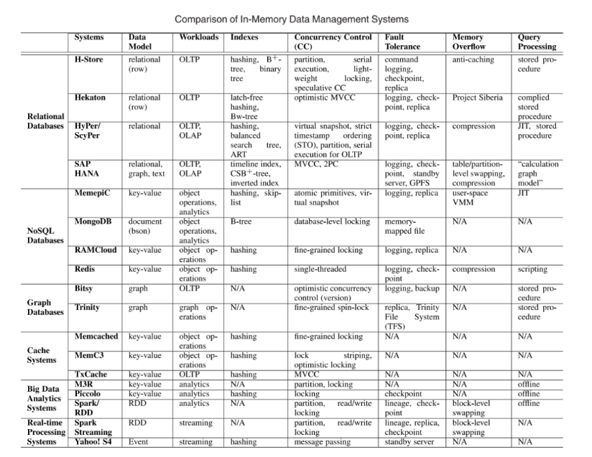

Slide 15
Conclusions
In-memory data management and processing is becoming increasingly important.
Because the cost of memory has decreased significantly in recent years, while the performance of CPUs has continued to improve. As a result, it is now feasible to store large amounts of data in memory, which can lead to significant performance improvements for data-intensive applications.
Shifting the data storage layer from disks to main memory can lead to significant performance improvements.
This is because disks are much slower than memory, so accessing data from memory is much faster than accessing data from disk. As a result, shifting the data storage layer from disks to memory can lead to significant improvements in response time and throughput for data-intensive applications.
The shifting prompts a rethinking of the design of traditional systems, especially for databases.
This is because traditional systems were designed for disk-based storage, and they do not take full advantage of the performance benefits of memory. As a result, there is a need to rethink the design of traditional systems in order to take full advantage of the performance benefits of memory.

Slide 16
Modern CPU utilization and memory-hierarchy-conscious optimization play a significant role in the design of in-memory systems.
This is because modern CPUs are capable of executing instructions much faster than the memory can deliver data. As a result, it is important to optimize the design of in-memory systems to ensure that the CPU is not starved for data. Additionally, it is important to take into account the memory hierarchy when designing in-memory systems, in order to ensure that data is stored in the most efficient location.
New hardware technologies such as HTM and RDMA provide a promising opportunity to resolve problems encountered by software solutions.
HTM (Hardware Transactional Memory) and RDMA (Remote Direct Memory Access) are two new hardware technologies that can be used to improve the performance of in-memory systems. HTM can be used to implement efficient concurrency control mechanisms, while RDMA can be used to reduce the latency of data transfers between nodes.

Slide 17
THANK YOU

Slide 18
References

